Slide 1
CoreFiling Pack
Lloyd’s User Guidance
Version 2.0
1 December 2025

Slide 2




CoreFiling Portal
How will the Portal work?
Introducing CoreFiling
Submissions
The CoreFiling Reporting Portal is a web-based application that allows filers to submit financial reports (filings) to Lloyd’s on a set schedule
The portal will accept iXBRL Syndicate Accounts (Interim/Annual) and iXBRL/XBRL Schedule 3 data
These filings are validated against XBRL specifications (Lloyd’s Taxonomy) and any additional validation rules as defined by Lloyd’s
Access to the CoreFiling Portal is a two step process, requiring:
  CoreFiling MFA approval (Security)
  CoreFiling Portal user profiles
User access guides are available at Syndicate Accounts & Financial Reporting - Lloyd's
Submissions will be aligned with the reported business timetable available: Business timetable - Lloyd’s
The portal obligations will be opened from the first business day following the period end to which the reporting relates
Access to Environment:

Slide 3
Lloyd’s CoreFiling Access Security
Steps to take if you require access to CoreFiling Portal
Step 1: Security setup (MFA)
Step 2. CoreFiling Portal setup
User Setup
Users request access to application via ‘Identity’: Identity@Lloyds
MFA Activation
Users login to CoreFiling Portal using Microsoft Authenticator https://lloyds.corefiling.com/
Devolved Admin
DAs within each Managing Agent will approve user requests via ‘Identity’
User Setup
Users request CoreFiling access type (preparer/approver) by sending an e-mail to Lloyd’s: Lloyds-MRD-ReturnQueries@lloyds.com
Portal Access
Following approval, users will see relevant obligations and be able to perform tasks within the CoreFiling Portal
Lloyd’s Admin
Lloyd’s Finance & IT teams review request implement within CoreFiling
User access guides are available at Syndicate Accounts & Financial Reporting - Lloyd's

Slide 4
CoreFiling User Profiles
Preparer and Reviewer profiles
Preparer Profile:
File preparers are assigned specific obligations (submissions) for their Syndicate for a specific due date
Preparers can upload filings but cannot submit them to Lloyd’s.
Preparers can review the validations report and clear errors prior to approver’s submission to Lloyd’s. This may include re-tagging or uploading a new file, if required.
Approver Profile:
Approvers are also assigned specific obligations (submissions) for their Syndicate for a specific due date.
Approvers will be required to allocate obligations to the preparers – see slide 10.
Only approvers can submit filings directly to Lloyd’s.
Approvers can review the validations report and request that preparers clear errors prior to submission to Lloyd’s. This may include re-tagging or uploading a new file, if required
When an approver clicks the submission button, it serves as confirmation to Lloyd’s that any validations that are uncleared have been reviewed and accepted.
Note: A user cannot be setup in CoreFiling with both profiles

Slide 5
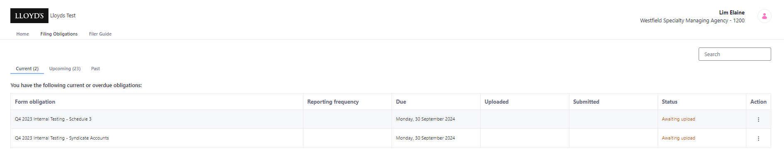
Obligations
What are they?
Obligations: Lloyd’s require these financial reporting filings to be submitted by the due date (as indicated)
These obligations include:
  iXBRL Syndicate Accounts (Interim and Annual)
  XBRL Schedule 3 (Annual only) (if applicable)
Next to the obligations the due date and the status of the current report is shown

Slide 6

Validations
Types of validation
Key validation checks have been configured within the portal, to ensure the uploaded tagged files meet Lloyd’s minimum requirements. There are three types of validations:
Mandatory Tags
The full listing of mandatory disclosures can be referenced in the illustrative accounts (s2.3.2).
Minimum Tags
The illustrative accounts represent the mandatory disclosures, unless they are nil or n/a for a syndicate.
Warning validation
Internal Consistency
To reflect this there are validations to flag if you have tagged each line in the primary statements.
Validates that the values in the primary statements are consistent with the totals with relevant notes.
Warning validation
e.g. Gross Premium Written value from Profit or Loss (Primary Statement) matches Gross Premium written Total (note 5- Analysis of underwriting result )
Presentational currency
Syndicate number
Schedule 3 True/False Flag
Foreign Exchange Rates (note 30)
A few examples below:
Blocking validations will require the file to be corrected and re-uploaded before submission.
Warning validations need to be reviewed and accepted by the approver before submission.
Fatal Errors
In addition to the above Lloyd’s-specific validations, the CoreFiling portal has a number of standard
validations to ensure the format of the file uploaded meets the standard iXBRL taxonomy format
Fatal errors will require the file to be corrected and re-uploaded before submission

Slide 7
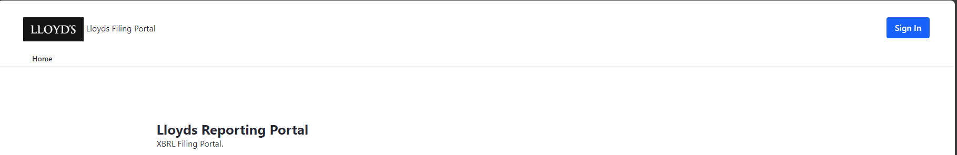
CoreFiling Portal
How to access CoreFiling Portal
Access to via link: Home - Lloyd's of London
Once here you will need to click > ‘Sign in’ button on the top right of screen.
Before logging in, two key steps must be completed (refer to slide 3):
Set up Multi-Factor Authentication (MFA) via Identity
Set up your profile within CoreFiling (preparer / reviewer)
Note: Both MFA (Identity) and CFL username must be the same e-mail address for successful login

Slide 8
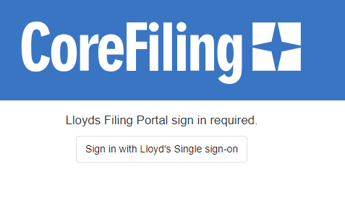
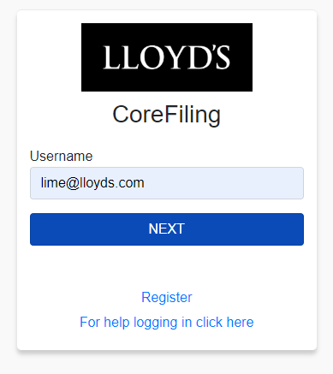
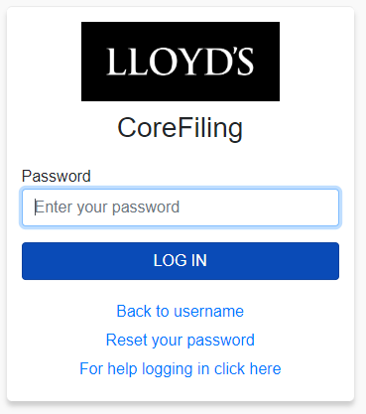
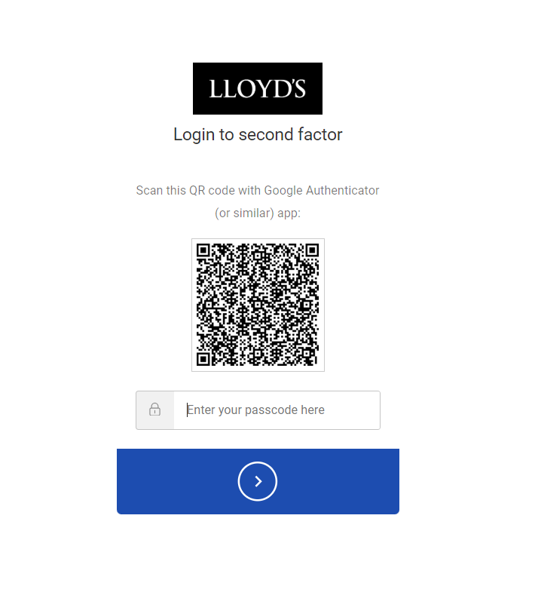
CoreFiling Portal – MFA
How to access CoreFiling Portal
By clicking ‘Sign-In’ this will take you to the single sign-on area
Enter Username
Enter Created Password
Scan QR in Microsoft Authenticator and enter code (scanning the code is required for first login only, subsequent logins will just require the code to be entered)

Slide 9
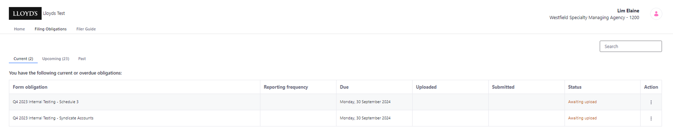
Home Screen
Both Preparers and Approvers will have the same home screen
Syndicate you are reporting for
Required reports to be submitted
Submission Due Date
Report Status

Slide 10
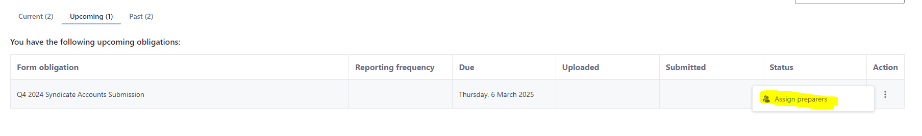
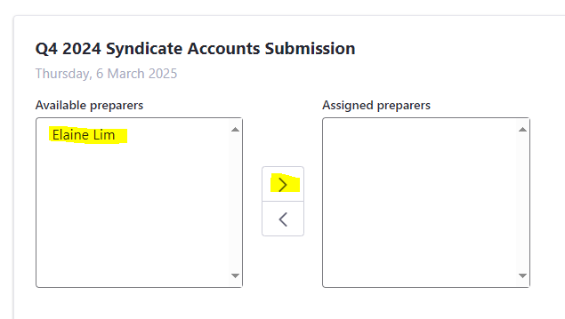
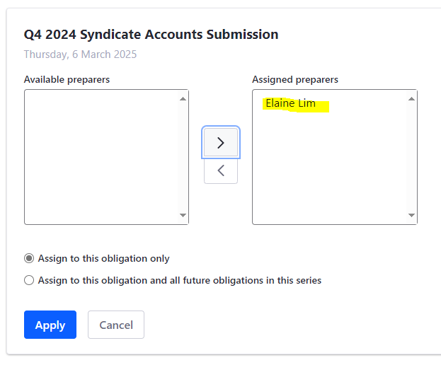
Allocation of Obligations
Approvers will need to allocate tasks to preparers
To assign obligations to preparers:
Each approver will be required to assign preparers to each obligation:
    Via the Approvers obligation screen, filings are shown in either the ‘current or upcoming’ tabs.
    To allocate > select 3 dots and select ‘Assign Preparers’
    Highlight the preparer from left box and click > to move to right box
    Decide if you are only assigning this obligation or for future obligations as well.
    Click ‘Apply’
    Preparers will now see the allocated obligation in their ‘Home’ screen

Slide 11
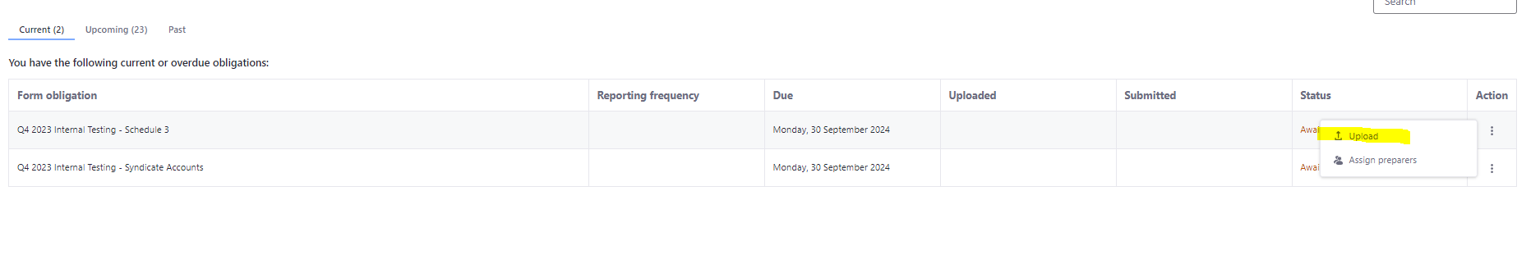
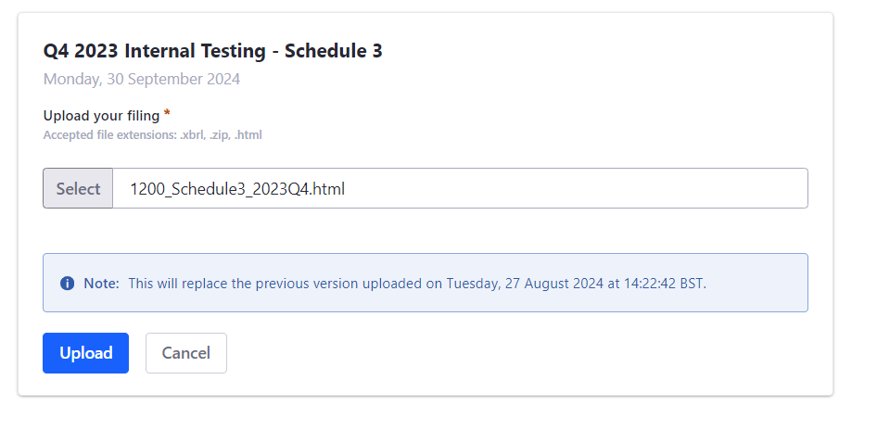
Upload Submissions
Preparers upload
Select 3 dots
To upload a file:
Files need to be uploaded with the correct naming convention: (if the naming convention is not right, it will not upload)
  Syndicate Number_Schedule3_Reporting Period: 9999_Schedule3_2023Q4
  Syndicate Number_Accounts_Reporting Period: 9999_Accounts_2023Q4
When submitting tagged filings on Lloyd’s portal the following file types will be accepted :
    .html
    .zip containing a single .html file
    .xbrl
    4. ixbrl report package which contains a single ixbrl
    document set according to ixbrl specification

Slide 12
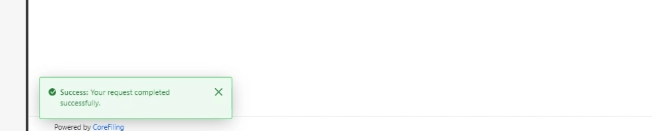
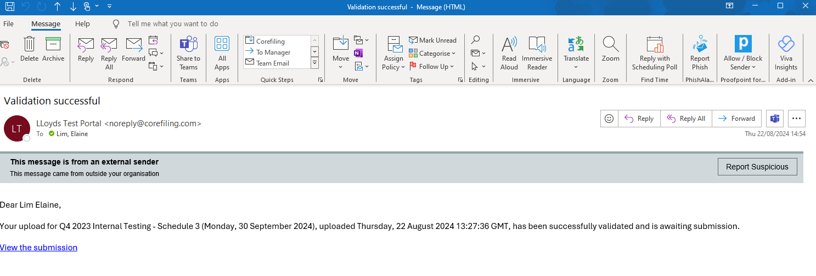
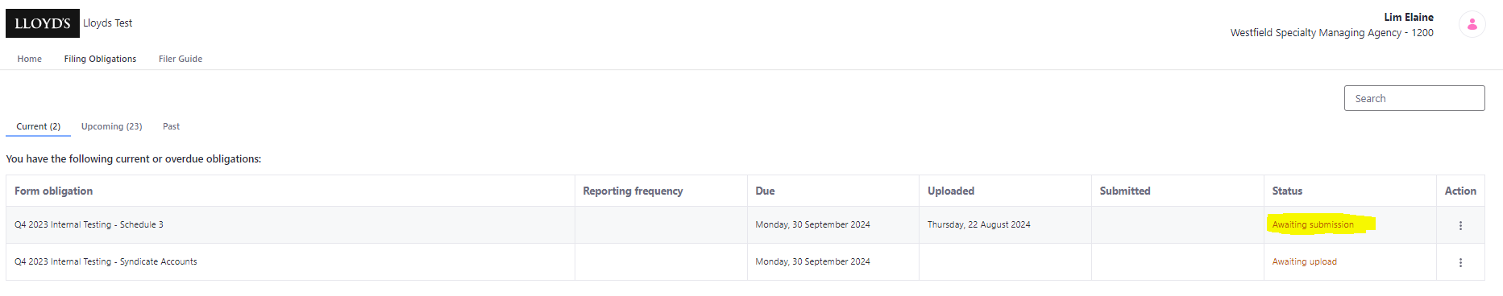
Successful Upload
Preparer success
If your upload is successful:
    You will see a message pop up in the left bottom corner of your screen as ‘success’
    The file will then be validated against Lloyd’s validation rules
Validation success:
    You will receive an e-mail to confirm the validation outcome.
    If validation errors/warnings appear, you can review these by clicking on the link via your e-mail
    Status will also be updated in your obligation screen

Slide 13
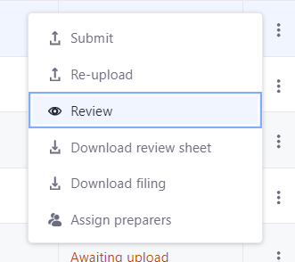
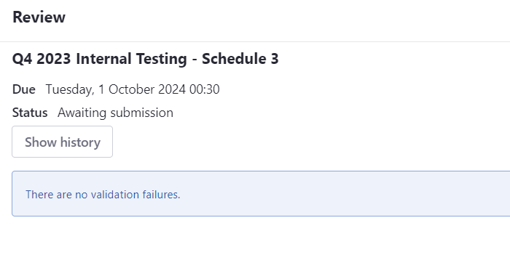
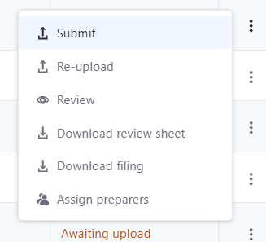
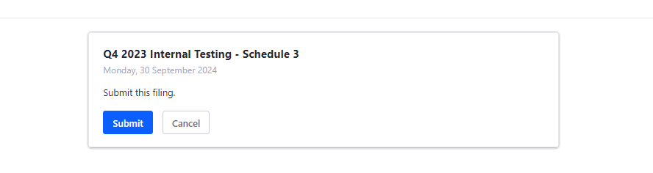
Submission to Lloyd’s
Approver submission
Once Preparers have completed their tasks the submission will require Approvers approval to submit to Lloyd’s:
    Via the Approvers obligation screen, filings with status ‘awaiting submission’ can be seen
    To review validations > select 3 dots and select ‘Review’
    Note: The checksum (MD5) code to be provided to auditors is also located on this 'Review' screen
    To submit to Lloyd’s, click the 3 dots and select ‘Submit’

Slide 14
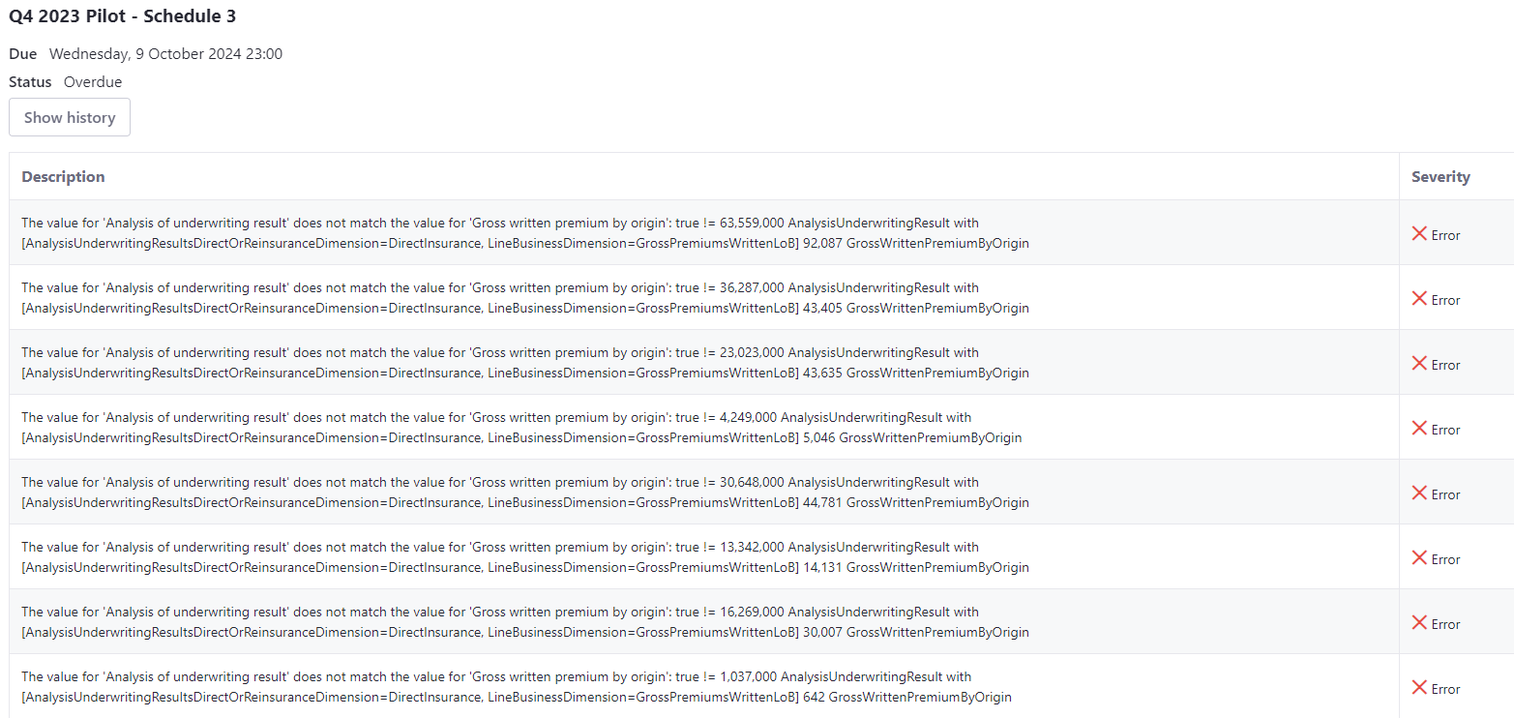
Validation Review
Sample validation screen
If your validation is unsuccessful:
    All ‘errors’ must be cleared
      This could mean potentially retagging and reupload of file
    All ‘warnings’ will require review and correction (if required)
    Any submissions with ‘warnings’ submitted to Lloyd’s will be assumed reviewed and approved by the approver and are appropriate.
    If upon Lloyd’s review the validations are invalid the file will be rejected and the Syndicate will need to resubmit.
Sample Validation report via CoreFiling

Slide 15
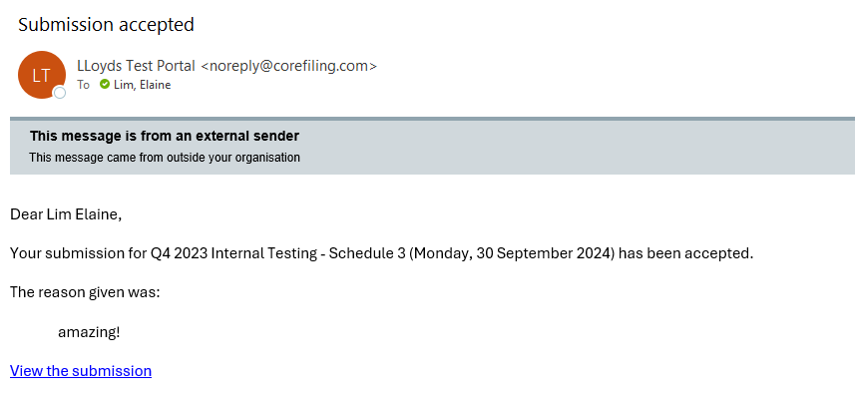
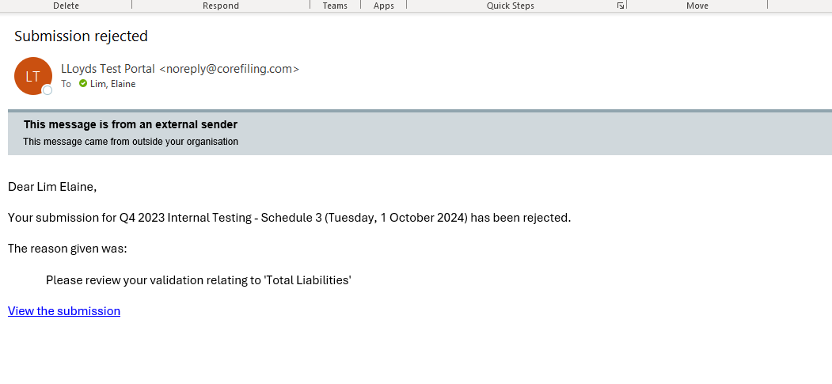
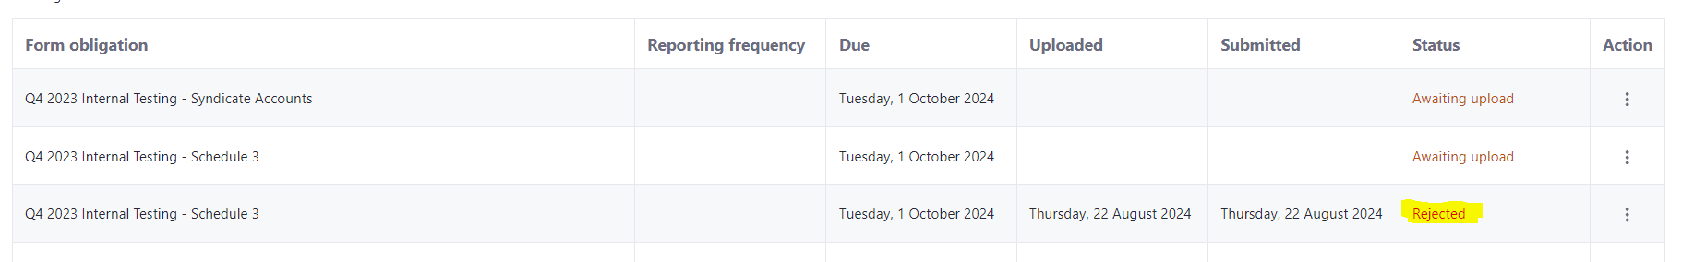
Submission Acceptance
Lloyd’s Approved/Rejected Files
Once Lloyd’s have received your submissions, the validations will be reviewed. Once reviewed, you will receive a 'Submission accepted' email.
There may be situations where your submission is ‘rejected’ . If your file is rejected, you will receive an e-mail with a reason for you to review. These issues will need to be resolved before re-submitting the files to Lloyd’s.
Successful submission:
Rejected submission:

Slide 16
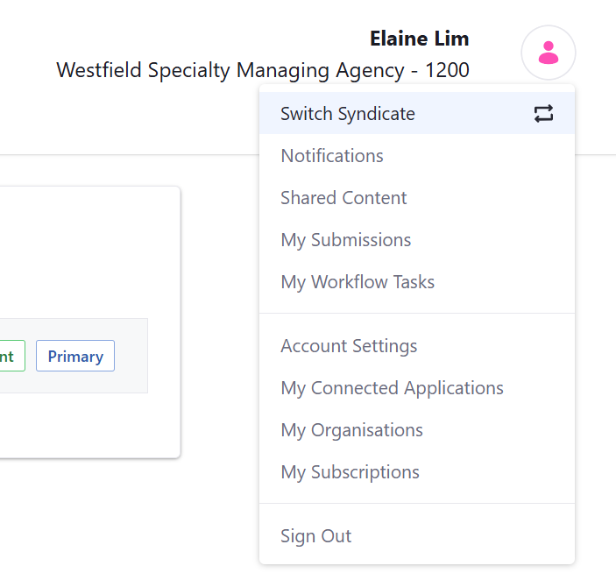
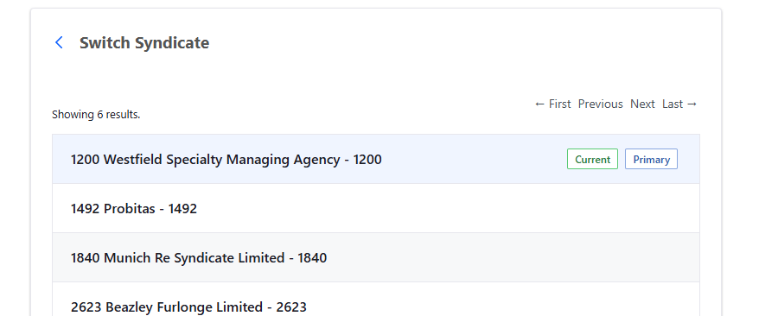
Multiple Syndicate Access
Managing Agents reporting for multiple syndicates
If a managing agent is managing multiple Syndicates, you will now be able to switch syndicates by navigating with the ‘Switch Syndicate’ functionality
    Navigate to your profile > select icon next to your name
    Select ‘Switch Syndicate’
    Click on the ‘Syndicate’ you want to change to
You should now see the new Syndicate name under your profile name.
You can now work on submissions for this Syndicate, repeat to change to another Syndicate
If a Syndicate is missing from the drop-down list, please email Lloyd’s Finance: lloyds-mrd-returnqueries@lloyds.com
All other processes previously discussed will be the same.
Note: Switch Functionality will only be available from 16th Dec 2025

Slide 17

Support

Slide 18



Support
Where to find help
 | We will respond to any queries you may have via the following email: lloyds-mrd-returnqueries@lloyds.com
 | A new dedicated central resource page, can be found via Lloyds.com via this link: Syndicate Accounts & Financial Reporting All published materials including Illustrative Syndicate Accounts, Instructions and Taxonomy, will be made available here.

Slide 19
Change Log
Updates from initial to 2025 Version
Version | Section/Slide | Page Number | Old Version Content | New Version Content | Rational
2025 | Cover Page | 1 | Version 1.0, 6 December 2024 | Version 2.0, 1 December 2025 | Version Control
2025 | Validations – Mandatory Tags | 6 | No reference to Syndicate Accounts Instructions | Reference to Instructions now included (s2.3.2). | Clarification for full listing of Mandatory Tags
2025 | Validations – Mandatory Tags | 6 | Examples required by Lloyd's | A few examples below | Clarification on Mandatory Tags
2025 | CoreFiling Portal | 7 | No information note | Note: Both MFA (Identity) and CFL username must be the same e-mail address for successful login | Clarification on User login requirements
2025 | Submission to Lloyd's - Approvers submission | 13 | No mention of checksum for auditors | “Checksum (MD5) code to be provided to auditors is located on the ‘Review’ screen” | New instruction for audit compliance
2025 | Multiple Syndicate Access | 16 | To select a different syndicate, user must log out and log in again | “Switch Syndicate” functionality allows switching syndicates from profile menu | Clarification on new functionality for New “Switch Syndicate” feature (available from 16 Dec 2025)
2025 | Multiple Syndicate Access | 16 | “If a Syndicate is missing, email Lloyd’s Finance” | Same, but process is now part of “Switch Syndicate” instructions | Process clarified and integrated into new feature

